Slide 1
The best of both worlds: Function-valued and character-state insights in variation on reaction norms

Slide 2
The two approaches – what can we do?
Function-valued approach
Character-state approach
Between ID variance of intercept and slope
Between ID variance of ‘traits’
Within ID between time-periods variance of intercept and slope
Repeatability at a specific temp
Within ID variance of ‘traits’
Between ID cov/cor between different ‘traits’
Repeatability of slope
Repeatability of intercept over different temporal scales
Within ID cov/cor between different ‘traits’
Between ID cov/cor of intercept-slope
Within ID between time-periods cov/cor of intercept-slope

Slide 3
The two approaches – what can we assume?
Function-valued approach
Character-state approach
Slope and intercept are considered as traits that selection can target
Selection can act on phenotypic trait in each environment separately
Phenotypic variation is heritable to some degree so that selection can act on this
Strength of selection is the same across the entire reaction norm
Strength of selection can vary in different environments

Slide 4
The two approaches – what can we learn?
Function-valued approach
Character-state approach
Constraints within and between individuals in intercept and slope – “Cold metabolic hypothesis” predicts that individuals with lower average trait expression should be more plastic to compensate and make use of potentially favorable conditions
Constraints within and between individuals in responses at different temperatures
Specialist and generalist trade-offs, do some individuals just do well at all temps? Or do some individuals excel at certain temps? Negative correlation between high and low temps at between ID level. If within…would be enzyme tradeoff.
Does stressful environments promote phenotypic variance?
What are the mechanisms to be more plastic while maintaining low MR?
Allocation/acquisition tradeoffs

Slide 5
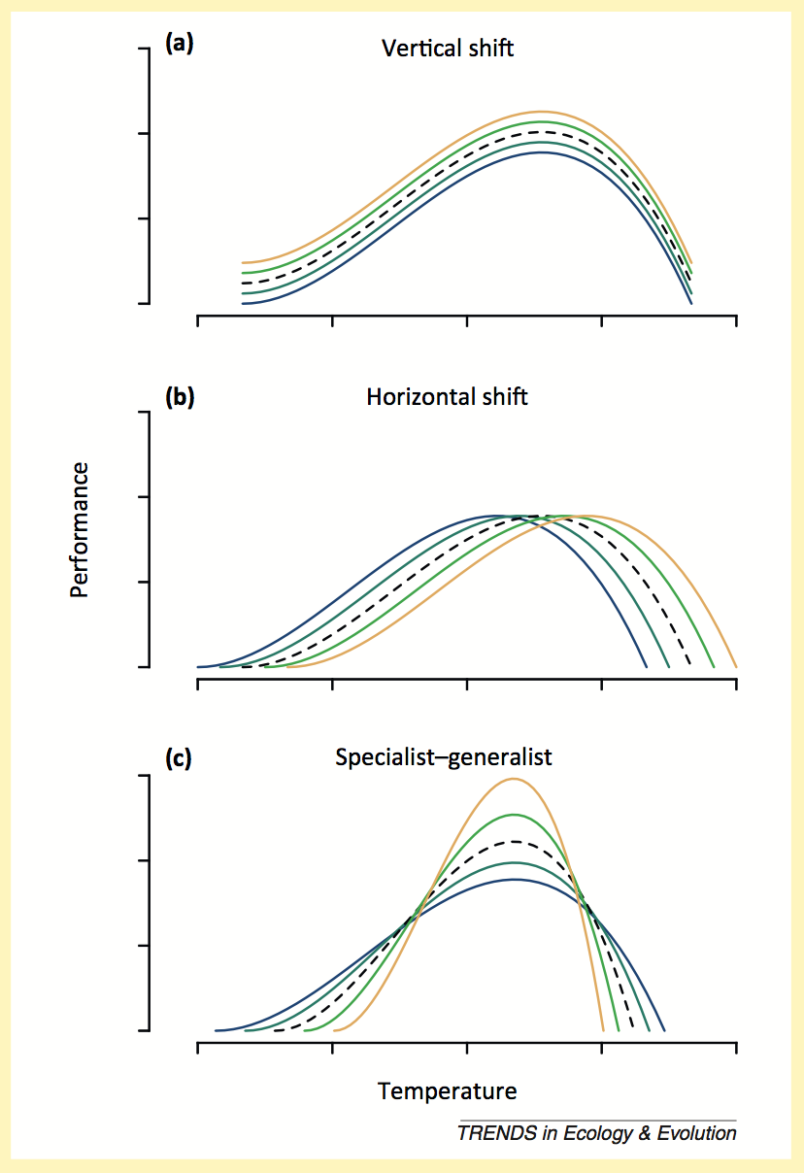
Predictions to detect trade offs in reaction norms
Hypothesis: Differences in resource allocation/acquisition can promote
elevational differences in MR. i.e. more resources, higher metabolic rate
Predict:
Repeatable slopes and traits at all temps
Positive covariance between intercept and slope at all temps (reaction norms don’t cross)
Positive correlation of MR between all temps
Hypothesis: Individuals can specialise/optimise MR at different temps, while others do more less okay at all temps.
Predict:
Negative correlation between high and low temps between individuals
Crossing of reaction norms (negative correlation with intercept and slope) Repeatable slopes and traits at all temps

Slide 6
F-V approach – Repeatability intercept and slope
Re-centering intercept - tells us about:
repeatability at intercept = average response at that temperature (needs to be a meaningful temp) i.e. Phenotypic variation in average response of MR as well as in plasticity of MR in response to temp
As well as slope = how flexible an individual is in response to temp

Slide 7
F-V approach – Repeatability intercept and slope

Slide 8
F-V approach – Repeatability intercept and variance comps

Slide 9
Character-state approach – Thermal repeatability and variance comps.

Slide 10
F-V approach – Repeatability slope and variance comps

Slide 11
F-V approach – Repeatability over time
Consistency in individual differences, the higher the better in the long term so selection can act on the variation in an evolutionary relevant time frame
This is essentially repeatability in the intercept so this very much depends on what the intercept is set at
Still don’t fully understand why can’t get Rslope over time..

Slide 12
F-V approach – Trade-offs between intercept and plasticity
Cov(int-slope) - dependent on where the intercept is centered at)
Changes after recentering: Tells us where reaction norms cross between what temperatures
If cov is positive, reaction norms may not cross
If cov is negative, crosses at some point greater than the intercept temp
Between individuals covariance: +ve, no support for metabolic cold hypothesis/compensatory hypothesis which predicts that low mr at low temps should be more plastic to take advantage of of responses to warmer temps. Variation in state between ID can drive positive covariance (Westneat, D. F., Wright, J., & Dingemanse, N. J. 2014). i.e. Responsiveness to temp is state dependent?? - big house, big car?

Slide 13
F-V approach – Trade-offs between intercept and plasticity
Within individual, between series covariance: -ve correlation, seems to support this compensatory hypothesis…. within an individual, reactions can cross…Why is compensation occurring at the within individual level??
Differences in state between IDs can mask trade-offs occurring in the within individual level (Careau and Wilson 2017)

Slide 14
Character-state approach – Thermal repeatability
Using this approach we can directly estimate repeatability at each temp, at the within and between individual level
Are these comparable with RN approach?
This approach is way easier but you can’t get estimate of how repeatable it is over time
Variance highest at 30 degrees. Their preferred temp?!
Repeatability decreases at 32 degrees

Slide 15
Character-state approach – Thermal repeatability and variance comps.

Slide 16
Character-state approach – BETWEEN ID Trade offs in responses between temperatures
*
*
*
*All significant
Can’t to intepret
*
*
*
All significant and positive
*
*
*
*
*

Slide 17
Character-state approach – BETWEEN ID Trade offs in responses between temperatures

Slide 18
Character-state approach – BETWEEN ID Trade offs in responses between temperatures
At the between ID level, covariances between responses increases with temp

Slide 19
Character-state approach – WITHIN ID Trade offs in responses between temperatures
*
*
*
*
*
*
*
*
*
*
*
*
*All significant
*
*
*
*
*
*
*
*
*
*
*
*
*
*
*
*
*
*
*
*
*
*
*
*
*
*
*
*
*
*
*
*
*
*
*
*
*
*
*
*
*
*
*
*

Slide 20
Character-state approach – WITHIN ID Trade offs of responses between temperatures
Within individual level: Responses at different temps are moderately +vely correlated
Is this an habituation response? Or a seasonal response?
Careau and Wilson 2017? Sink and swim trade-off in performance?

Slide 21
Character-state approach – WITHIN ID Is this an habituation or a seasonal response?

Slide 22
Conclusions
Plasticity is repeatable as!

Slide 23
Character-state approach – Thermal repeatability and variance comps.

